Slide 1
Student evacuation procedures
Saint Kentigern college

Slide 2
One out, all out
One building out, all buildings out – in an evacuation
  When we evacuate any building at the College, ALL BUILDINGS are EVACUATED as many of our buildings are clustered close to each other
    The most common reason for an evacuation is a fire alert.

Slide 3
Evacuation signal
What to listen for
The continuous ringing of bells, or siren, or in some buildings a voice over alarm.

Slide 4
Exit the building/area immediately
As soon as you identify it is an evacuation
    Exit and go to the safe assembly point
    Don’t go into buildings to gather up your belongings
    If your bag is next to you, you may take it – so long as it doesn’t inhibit your (or others) safe movement or slow you down from getting out of the building

Slide 5
Go to the evacuation assembly point
The field opposite EMC, adjacent to t-Block
    Walk calmly
    Walk around buildings using the road footpaths - not through buildings, not directly alongside buildings.
      We want to avoid queues of people fitting in small spaces
      We want everyone to be aware of scenarios like a window exploding outward to think about how far is safe from buildings
      It may mean taking the long way by using roads – better to be safe than rush.

Slide 6
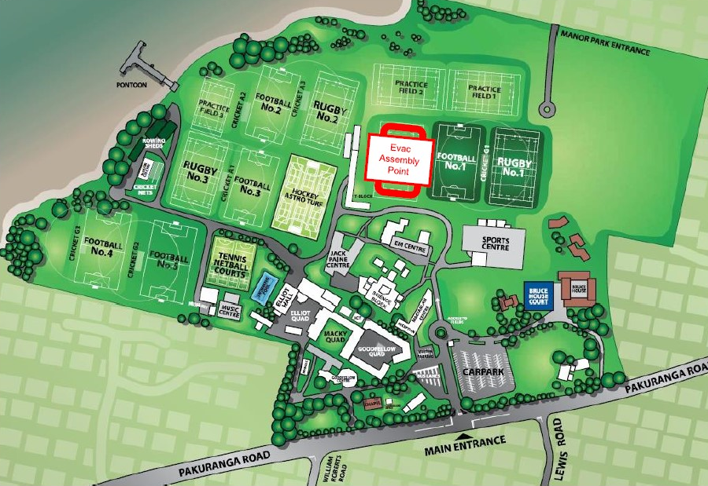
evacuation assembly point
The field opposite EMC, adjacent to t-Block

Slide 7
At the evacuation assembly point
The field opposite EMC, adjacent to t-Block
On the field
    Keep voices down
    Follow the instructions of teachers
      You may be asked to line up by Tutor Group & House
      Roll call is not required – Building Wardens (staff trained) check buildings to ensure no one is inside.
      Remain on the field until you are given instruction otherwise
      Dependent on the emergency, and the time it takes to confirm everyone is gathered, the time on the field will vary

Slide 8
What if it is raining
You still need to assemble on the evacuation field
    Building Wardens and teachers won’t necessarily know what and where the emergency is at the time everyone is assembling
    We need to be able to communicate to everyone
    If the site manager advises it is safe to move and assemble in the Gyms to shelter from the rain, then you will be given instruction to move to the Gyms and assemble in House areas.
    Until such a time, you need to assemble on the field

Slide 9
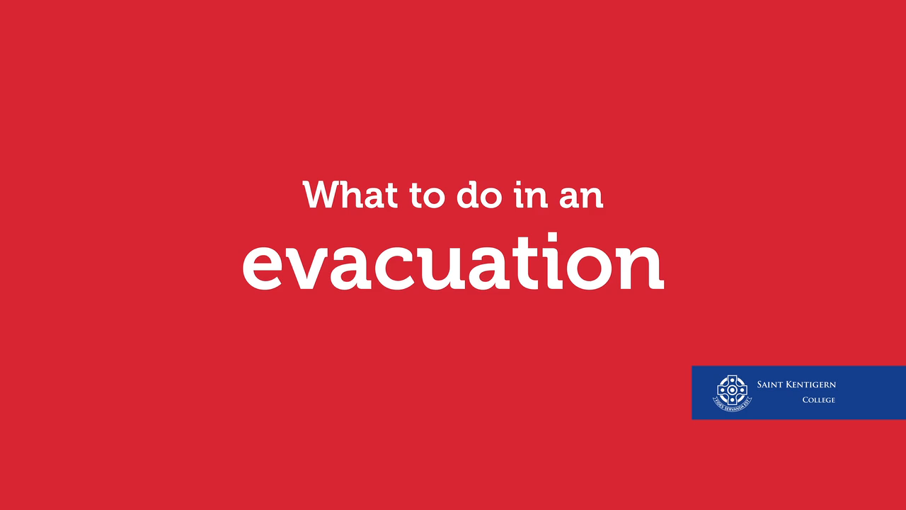
Be ready
There is a practice evacuation in the coming week
Hover over the image below, then click play to watch the evacuation video

Slide 10
evacuation assembly point
The field opposite EMC, adjacent to t-Block

